Slide 1
s.u.r.e. skill series:
Be a smart fact-checker
This deck is for sharing purposes only. Please do not distribute without permission. For enquiries, please e-mail sure@nlb.gov.sg

Slide 2
Learning points
What is fact-checking?
Facts versus opinions
Guidelines for fact-checking
Fact-checking Websites

Slide 3
What is s.u.r.e.?
https://youtu.be/JNFnPqTTPIc

Slide 4
1) WHAT IS FACT-CHECKING?

Slide 5
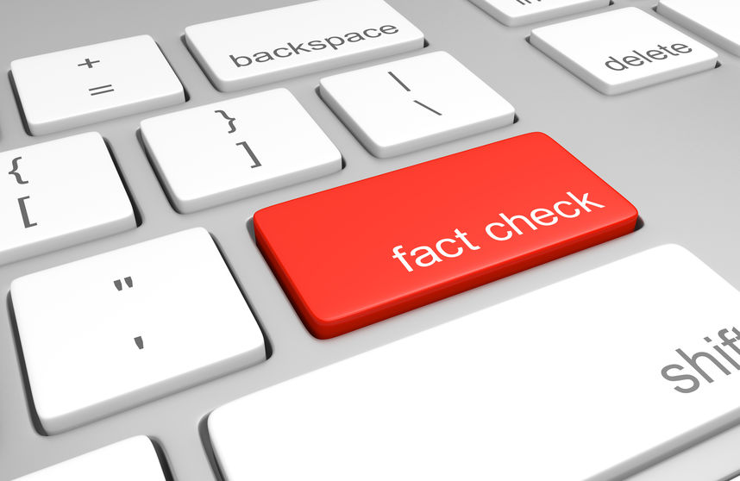
What is fact-checking?
A process of verifying the information you receive to ensure that they are accurate
Information can be from:
Online articles
Social media posts
Forwarded messages
Hearsay from people

Slide 6
2) Facts versus Opinions

Slide 7
facts
Know the difference between facts and opinions
Knowing how to distinguish between facts and opinions helps us discern the information surrounding us
opinions
A thing or statement that is known or proven to be true
E.g. The COVID-19 vaccine is safe for use in Singapore as it meets safety and efficacy standards with benefits outweighing known risks
Source: Ministry of Health (link)
An expression based on personal beliefs or views
E.g. “I believe that the vaccine will give me a heart attack! I read it on Whatsapp.”
An opinion or personal belief is much harder to change in a person

Slide 8
Know the difference between facts and opinions
Click here for infographic

Slide 9
3) Guidelines for Fact-checking

Slide 10
Guidelines for fact-checking
Keep an open mind. Fact-checking is about gathering evidence, so keep your personal beliefs and opinions aside
Read and analyze the information you receive thoroughly
Be prepared to always do quick-checks. They only require a small amount of time, and can develop you into a better fact-checker

Slide 11
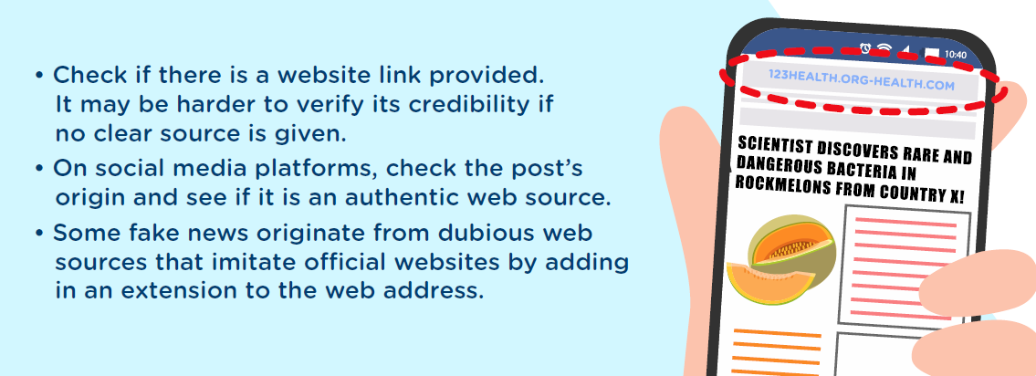
Guidelines for fact-checking
Click here for infographic

Slide 12
Suspicious extension to website ‘sg-giftcard.com’
Retailers or supermarkets do not give out gift cards without purchases
Call to ‘Inform 15 Whatsapp friends about this promotion’

Slide 13
4) Fact-checking websites

Slide 14
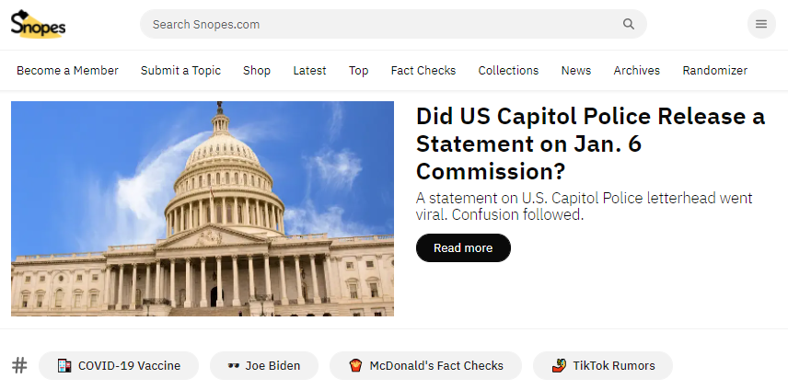
Snopes
Established fact-checking site with a wide database of fake news cases from past and present
Good for international or western-based articles
Limited cases from Singapore and Southeast-Asia

Slide 15
activity
Type in ‘snopes.com’ in browser
Select search icon at top of screen
Enter ‘mh370’ in search bar
Share the article titles in the chat.

Slide 16
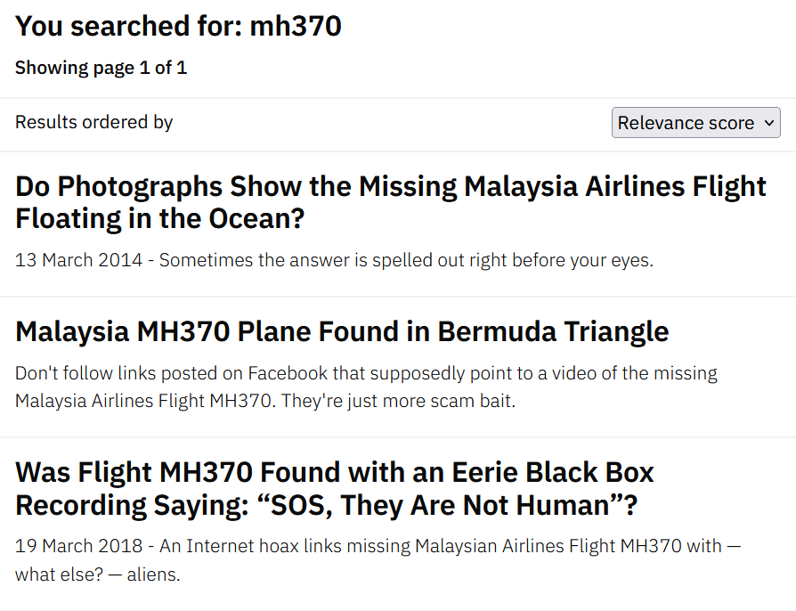
Snopes
Multiple fake articles or posts can be created about unsolved mysteries or tragedies
It is important to not let emotions take over when coming across such articles or posts

Slide 17
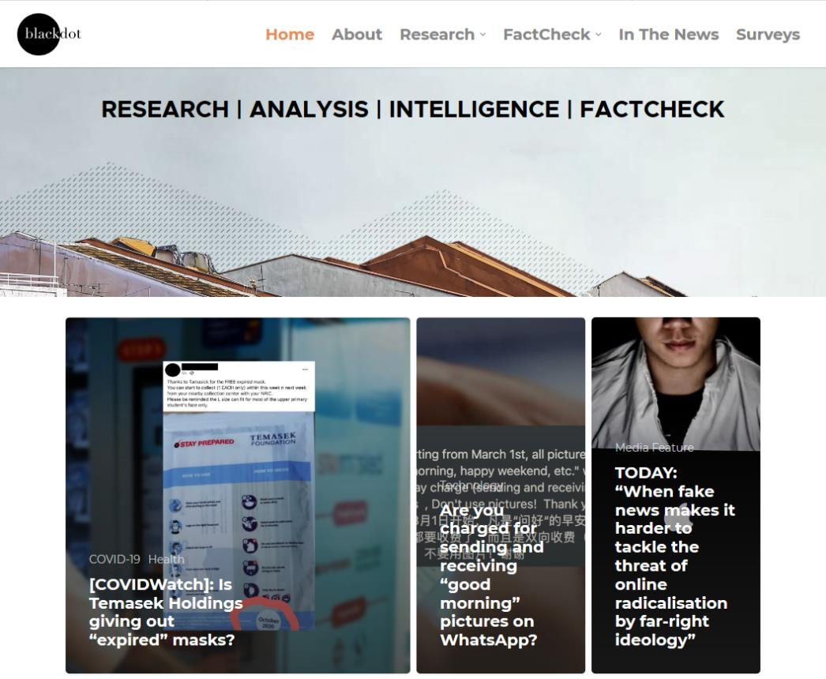
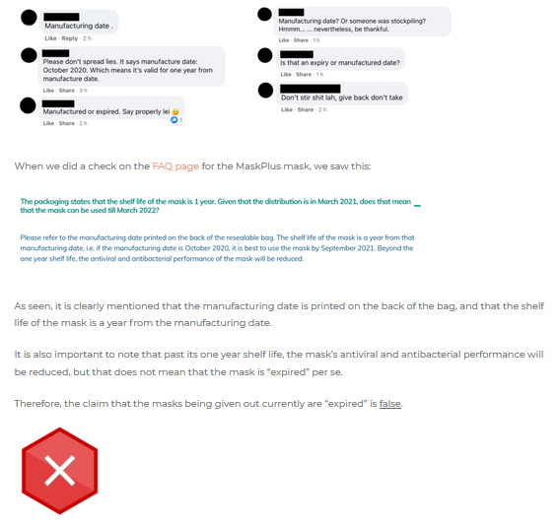
Black dot research
FactCheck section covers several recent cases of online misinformation in Singapore
Each article shows the original message or news being spread, and breaks it down with research to arrive at the verdict (True or false)

Slide 18
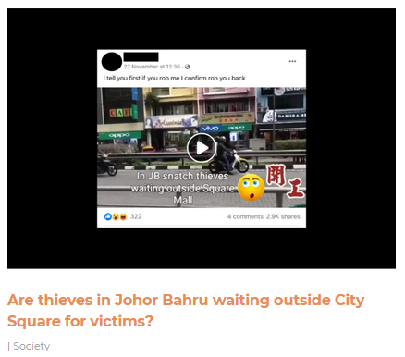
activity
Type in ‘blackdotresearch.sg’ in browser
Close the pop-up survey
Select ‘Are thieves in Johor Bahru waiting outside City Square for victims?’
What is the verdict of that article?
Share your answer in the chat.

Slide 19
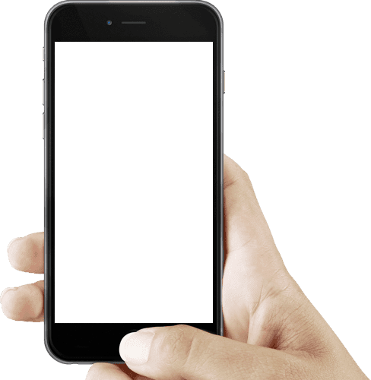
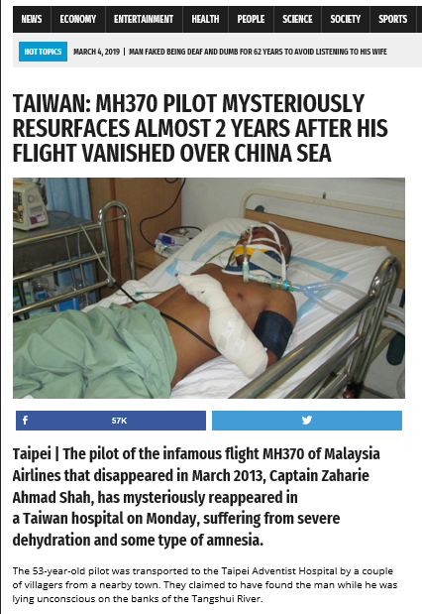
Reverse image searching (smartphone)
1) When you receive or see a suspicious image on your smartphone, save it to your phone first
Save the suspicious image into your phone
Taiwan: MH370 Pilot mysteriously resurfaces almost 2 years after his flght vanished over China Sea, World News Daily Report

Slide 20
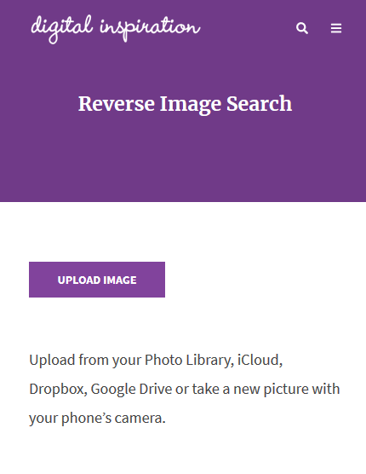
Reverse image searching (smartphone)
2) Open your phone browser and access ‘reverse.photos’
3) Tap ‘Upload Image’ and select the photo from your phone gallery
reverse.photos
Upload picture from your phone gallery

Slide 21
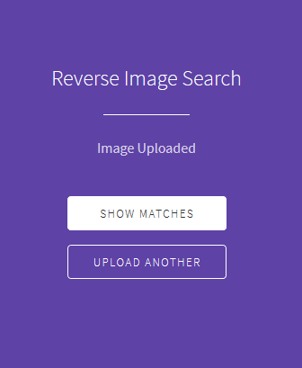
Reverse image searching (smartphone)
4) Tap ‘Show Matches’ to see all image-match results
See all image-match results to draw conclusion

Slide 22
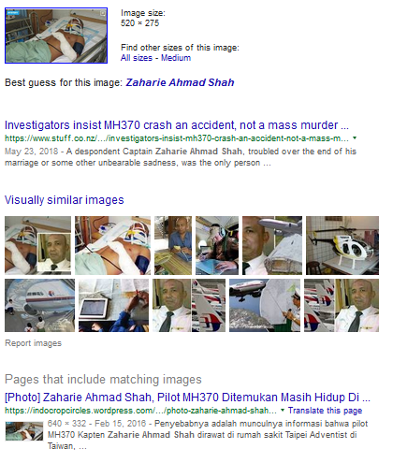
Reverse image searching (smartphone)
5) Analyze the different website matches to check if the photo has been duplicated and used in separate articles

Slide 23
LESSON RECAP
Fact-checking focuses on evidence, not personal opinions
Keep an open mind and take active steps in checking the information we receive
Keep yourself updated on the latest fake news cases from fact-checking websites

