Slide 1
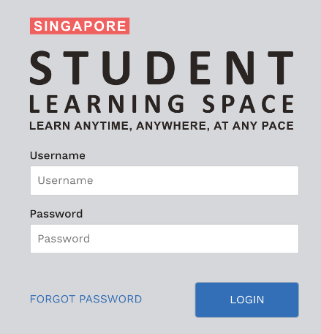
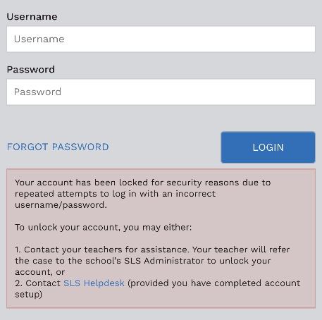
CAN’T LOG IN TO SLS?
FORGOT YOUR USERNAME?
A student’s SLS username comprises the first 5 characters of his/her name, followed by the last 5 characters of his/her NRIC/FIN/BC ID. (e.g. ADAMB4567Z)
FORGOT PASSWORD?
Use email to reset
(ensure you set it up first)
Answer security questions
Ask your teacher to reset
Contact the school helpline
Call/email the helpdesk*
ADAM BOY
+
T1234567Z
ACCOUNT LOCKED?
Contact the school helpline
Call/email the helpdesk*
1
2
1
3
2
4
5
School Helpline: zhenghua_ps@moe.edu.sg
SLS Helpdesk: 6702 6513 helpdesk@sls.ufinity.com go.gov.sg/loginissues (Mon-Fri: 9am-9pm, Sat: 9am-3pm)

